Slide 1




Interventions for Autism
Taylor Frazier and Danae Pena

Slide 2





UNDERSTANDING AU INTERVENTIONS WHILE
SUPPORTING YOUR CHILD’S DEVELOPMENT

Slide 3



IMPORTANCE OF INTERVENTIONS
Autism interventions are crucial because they address key developmental areas such as communication, social skills, behavior, and adaptive functioning.

Slide 4


BUT FIRST
POP QUIZ!!

Slide 5


WHAT WE WILL DISCUSS
What is Autism?
What are the differences between AU and other special education eligibilities?
Autism Interventions

Slide 6


GOALS
Learn what autism looks like compared to other SPED elegibilities
Learn about the different types of interventions.

Slide 7


WHAT IS AUTISM?
  Autism is a special education disability category under IDEA 2004 and is characterized as a developmental disability that significantly effects Verbal Communication, Nonverbal Communication, and Social Interaction. Other characteristics often associated with autism include: engagement in repetitive activities and stereotyped movements, resistance to environmental change or change in daily routines, and unusual responses to sensory experiences.

Slide 8
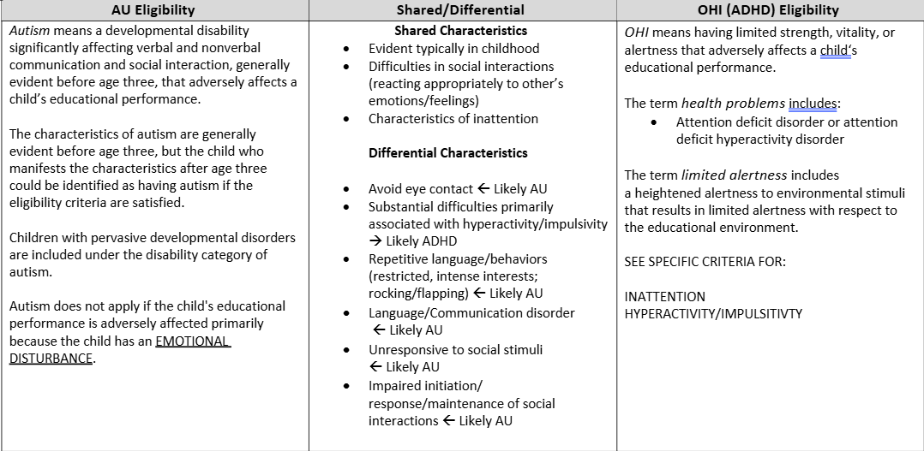
DIFFERENTIATING SYPTOMS AND WHY THESE ARE IMPORTANT ALSO
Autism v.s. ADHD

Slide 9
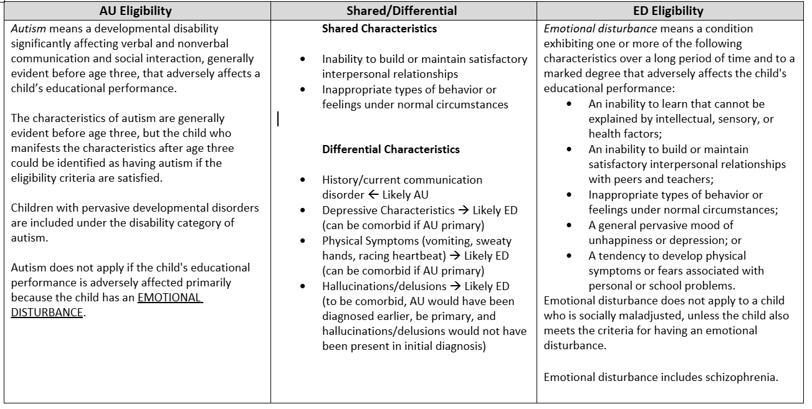
DIFFERENTIATING SYPTOMS
Autism vs. ED

Slide 10

WHY INTERVENTIONS MATTER
GOALS OF INTERVENTIONS
  By providing structured support, interventions help individuals with autism navigate everyday situations, build self-esteem, and participate more fully in educational, social, and community settings. Ultimately, they can enhance the overall quality of life for both individuals with autism and their families.

Slide 11
TYPES OF INTERVENTIONS
  ABA,
  Developmental approaches,
  Educational interventions,
  Occupational and Speech Therapy
  Remember ! Early intervention is the best intervention!

Slide 12
EARLY INTERVENTION
  The sooner you identify something that may need attention—such as during developmental appointments—the better. Never hesitate to advocate for your child.

Slide 13
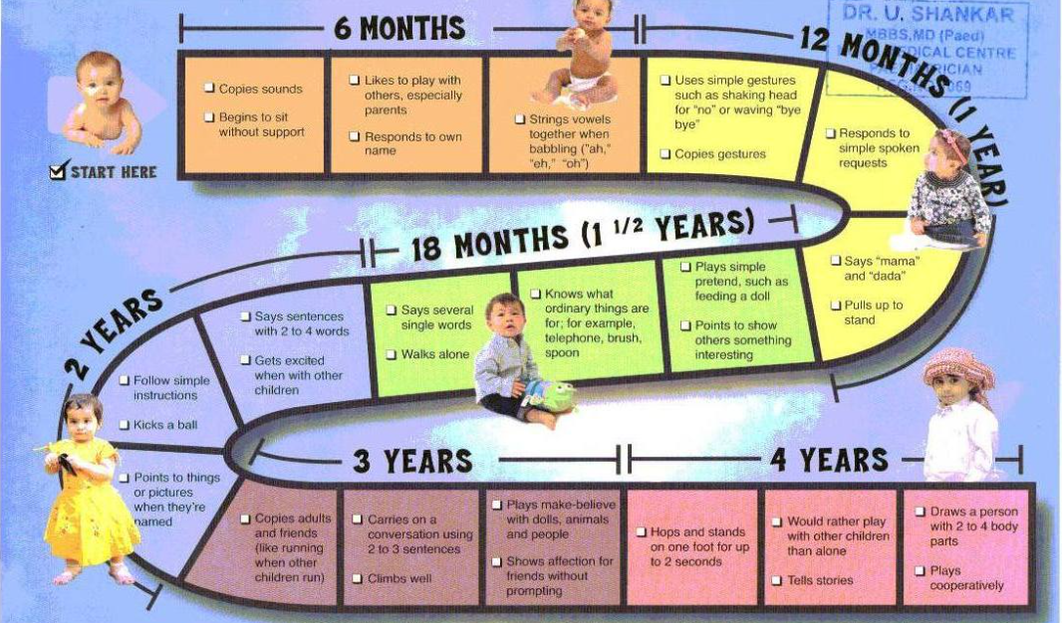
DEVELOPMENTAL APPROACHES

Slide 14
ABA
  ABA therapy is typically done through one-on-one sessions with a trained therapist. The therapist uses positive reinforcement to encourage desired behaviors and reduce unwanted ones. Techniques include breaking down tasks into smaller, manageable steps, reinforcing progress, and using specific strategies to improve skills in areas like communication, social interaction, and daily living.
  Sessions often take place in various settings, such as at home, school, or therapy centers. The approach is highly individualized, with goals tailored to the child’s specific needs and progress continuously monitored and adjusted.

Slide 15
EDUCATIONAL INTERVENTIONS IN FBISD
  Fortbend independent school district conducts testing for children at age 3-5 who have been referred by their parents or school staff and are suspected to have autism. If the testing is concluded that the student is AU elligible the student may be able to be placed in a school program called ECSE.
  Early Childhood Special Education (ECSE) Services are offered to students with identified developmental delays who are 3-5 years old.

Slide 16
FORTBEND PROGRAMS AND SUPPORT SERVICES CONT.
Communication Language and Social Skills (CLaSS) Services
  CLaSS provides social and/or behavioral services for students who are able to function academically in the lesser restrictive setting, but require social and/or behavioral support in order to facilitate the development of socially appropriate behaviors.

Slide 17
FORTBEND PROGRAMS AND SUPPORT SERVICES CONT.
Communication Language and Social Skills Plus (CLaSS Plus) Services
  CLaSS Plus services are designed for students who exhibit significant challenging behaviors and require social, emotional and behavioral support to facilitate the development and demonstration of appropriate behavior and functioning in the school setting.

Slide 18
FORTBEND PROGRAMS AND SUPPORT SERVICES CONT.
Succeeding in Academic and Independent Living Skills (SAILS) Services
  Succeeding in Academic and Independent Living Skills (SAILS) services are designed to provide students with significant cognitive disabilities an educational program focusing on life skills such as personal care, pre-vocational activities, communication, functional academics and/or social skills.

Slide 19
FORTBEND PROGRAMS AND SUPPORT SERVICES CONT.
Academic, Behavior, and Communication (ABC) Services
  Academic, Behavior, and Communication (ABC) services are designed for students who exhibit a combination of severe cognitive, communication and behavioral challenges.

Slide 20
OT AND SPEECH
  Speech Therapy is an instructional arrangement for providing speech therapy services.
  Occupational Therapy helps children improve daily living skills, such as dressing, eating, and fine motor coordination.

Slide 21
OUTSIDE OT
Occupational therapy (OT) helps people work on cognitive, physical, social, and motor skills. The goal is to improve everyday skills which allow people to become more independent and participate in a wide range of activities.
  Independent dressing
  Eating
  Grooming
  Using the bathroom
  Fine motor skills like writing, coloring, and cutting with scissors
  etc.

Slide 22
OT WITHIN THE SCHOOL
School based occupational therapy:
Occupational therapists in the school system are focused on supporting a child’s overall ability to participate as successfully and fully as possible in the school environment. OT’s focus often includes:
fine motor functioning
sensory processing
visual motor & visual perceptual skills
social skills
cognitive skills
executive functioning

Slide 23
SPEECH THERAPY
Speech therapy for autism can help improve verbal and nonverbal communication skills. It targets social communication and interaction skills, helps with frustration, and builds self-confidence. Strategies include:
  Augmentative Alternative Communication (AAC) for children unable to talk Voice output device, picture communication system, sign language)
  Encouraging functional communication.
  Integrating speech therapy activities across settings.
  Addressing common speech problems.
  Promoting long-term improvements.

Slide 24
PARENT-IMPLEMENTED STRATEGIES!
Structured Routines:
  Consistent daily schedules improve predictability and reduce anxiety.
  Clear expectations help children feel secure and focused.
Reinforcement:
  Reward positive behaviors to encourage repetition.
  Use praise, tokens, or activities for motivation.
Modeling:
  Demonstrate behaviors you want to see in your child.
  Children learn by observing parental actions.
Consistency:
  Consistent responses create a stable environment.
  Reinforce rules across all caregivers and settings.

Slide 25

PARENT-IMPLEMENTED STRATEGIES!
Parent Support:
  Seek professional guidance and parent networks for advice.
  Collaboration helps manage challenges and share ideas.
Self-Care:
  Prioritize your well-being to be an effective caregiver.
  Rest, relaxation, and hobbies keep stress in check.

Slide 26
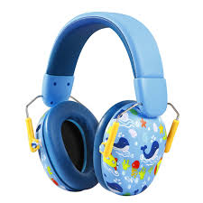
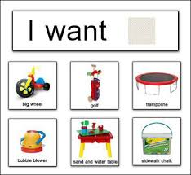
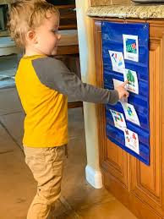
ASSISTIVE TECHNOLOGY
Some inexpensive Assistive Technolgy for students with Autism include:
  Visual Aids (clocks,timers,calendars, visual schedules)
  Noise cancelling headphones
  PECS Board

Slide 27
CONCLUSION
Organizations
Q and A.
Resources!!!!

Slide 28
Resources
http://www.texanacenter.com/
http://pediatrics.aappublications.org/content/120/5/1162.full
• Autism Society: www.autism-society.org • Easter Seals Program: http://www.easterseals.com/search-results.html? q=autism&search_submit.x=0&search_submit.y=0
• US Department of Health and Human Services: www.hhs.gov/autism
• Organizations for Autism Research www.researchautism.org
• Treatment and Education of Autistic and Communication related handicapped Children: http://www.teacch.com
• The Autism Internet Modules provide comprehensive, up-to-date information on autism that is applicable to educators, other professionals, and families who support individuals with autism. http://autisminternetmodules.org

Slide 29
Resources
Autism Speaks provides links to 40 useful toolkits: https://www.autismspeaks.org/family-services/tool-kits
• Autism Speaks: Family Services School Community Tool Kit:
•http://www.autismspeaks.org/sites/default/files/school_community_tool_kit.pdf
• Autism Speaks: The First 100 Day Kit
http://www.autismspeaks.org/docs/family_services_docs/100_day_kit.pdf
• American Academy of Pediatrics: Management of Children with Autism Spectrum Disorders:
http://pediatrics.aappublications.org/content/120/5/1162.full
• Autism Society: www.autism-society.org

Slide 30
BEFORE YOU GO!

Slide 31
Thank You

